Slide 1
Depression Awareness Project
A TIDAL 2025 submission by David Arnold, Freddy Cortez, Sebastian Garcia, and Robert Jordan

Slide 2
Overview
Our project focuses on building an interactive application that allows the user to fill out a survey questionnaire in order to receive a predictive diagnostic from a trained random forest AI model.
Many students and professionals silently suffer from depression and we hope to help this crisis by providing the needed resources through a preliminary diagnostic. We can improve the overall mental well being of the population by having a large scale and easy to use application to give predicative results and provide resources simultaneously.

Slide 3
Motivation
Intervention – Using an interactive application in the form of a questiare style survey, we can use an AI model to predict whether or not an individual may or may not have depression.
Accessibility – Not everyone has access to mental health professionals or have the capacity to do so. This tool is a first-step to checking if an individual should consider making it a primary goal to seek help if they are unsure.
Reducing Stigma – Some individuals may feel uncomfortable discussing their mental health with others. AI models can provide a private, non-judgmental way for them to assess their mental well-being.
Scalability – This application can be deployed on a large scale to reach many users at a low cost. This can help provide the necessary resources for each individual by giving them a predicted diagnosis and offering the needed solution or recommendations.

Slide 4
Methods
To train our model, we found a publicly available dataset that had 18 self-reported questionnaire answers and whether or not each individual was clinically diagnosed with depression.
We dropped unimportant variables such as name and city of location. We also grouped students, working professionals, and degree to increase the working training/test datasets and provide a more general model.
After additional data manipulation, we trained a random forest model to predict whether or not a person has depression based on the remaining variables. We then decided to drop insignificant (low feature importance scores) to lower redundancy in our model and make the survey within the application more convenient while keeping a high level of accuracy.
We then developed a user-friendly application catered to Texas A&M students that ask the user a series of questions and then uses that information to input in to the AI model to generate a predictive diagnosis for the user. It also provides any necessary resources and recommendations based on the diagnosis.

Slide 5
Technical Results And Development

Slide 6
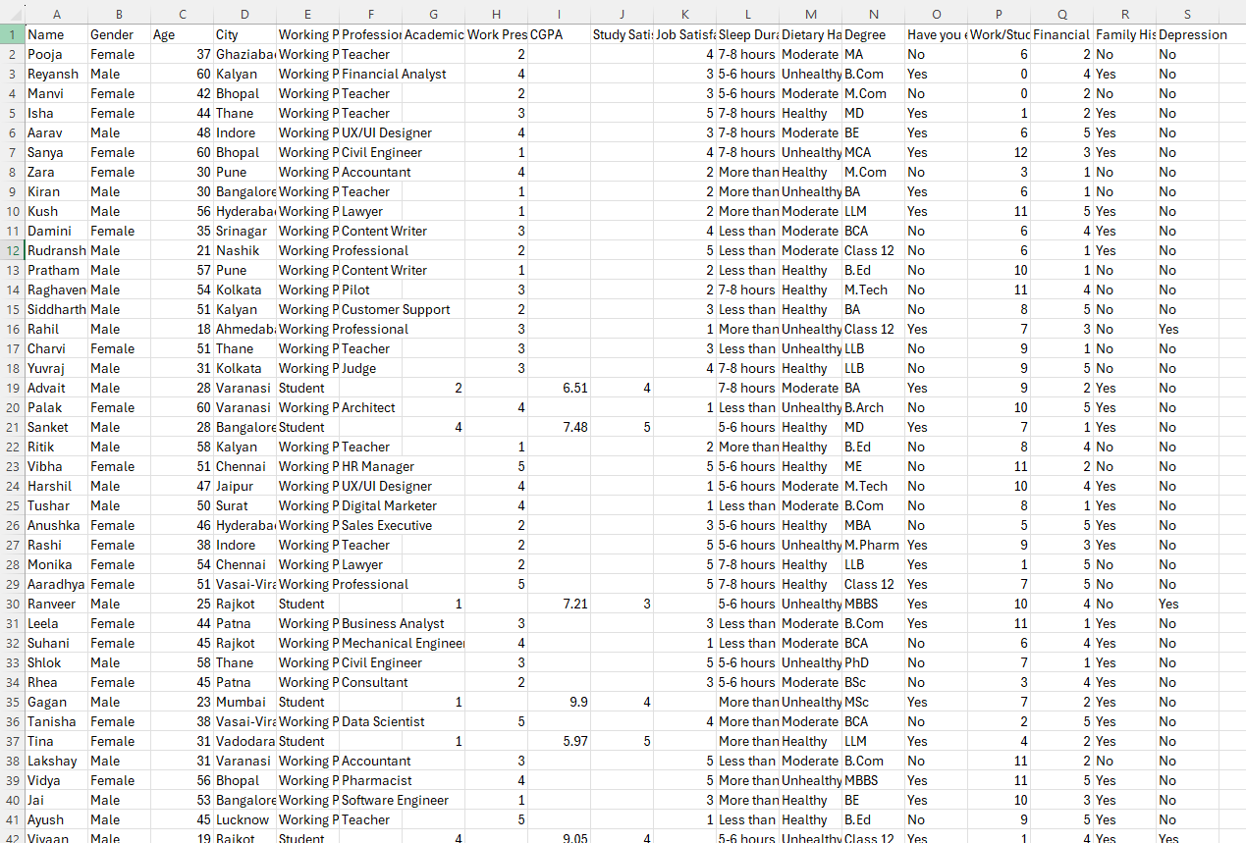
Dataset
Sample size of
2556 responses.
Blank data was mean-filled in order minimize impact on the model while preserving data.

Slide 7
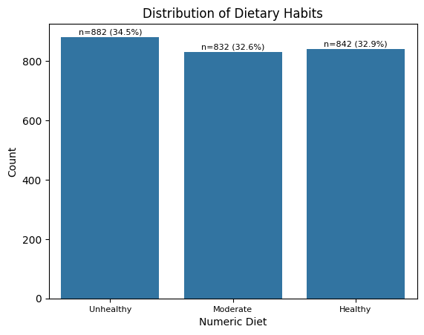
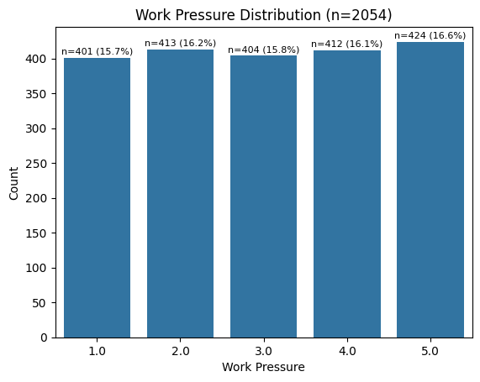
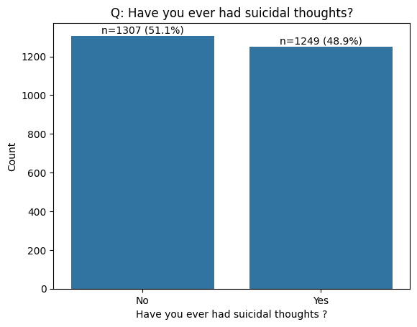
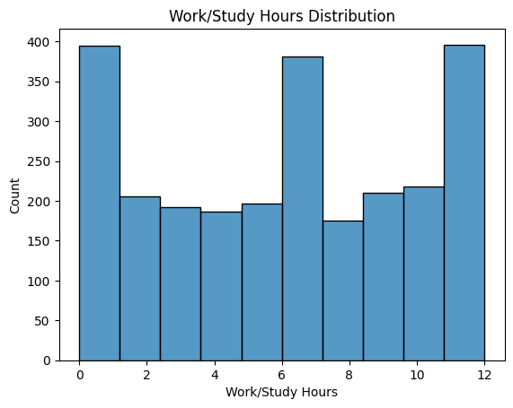
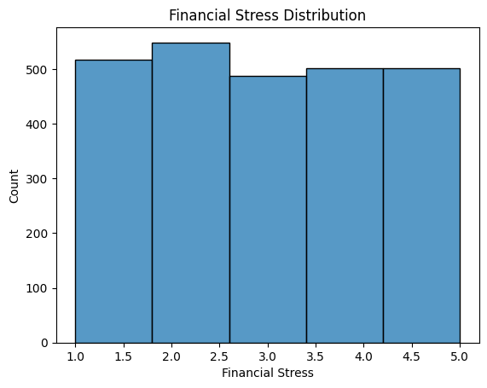
Variable Distributions

Slide 8
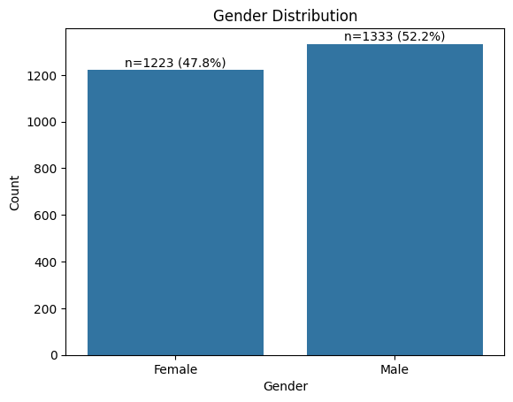
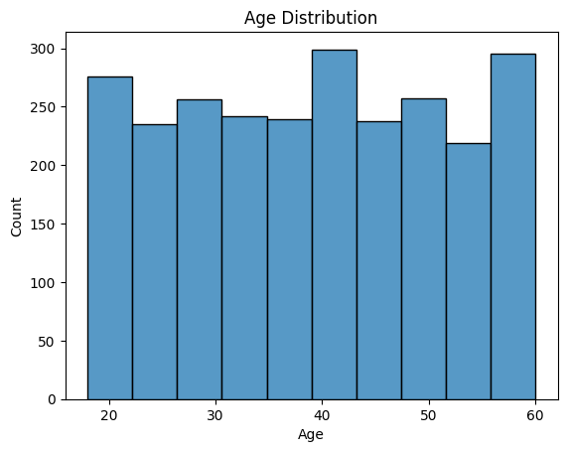
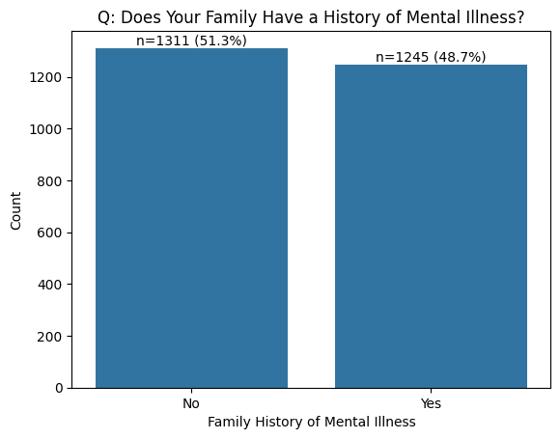
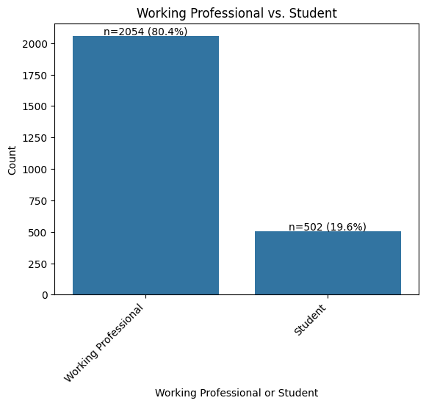
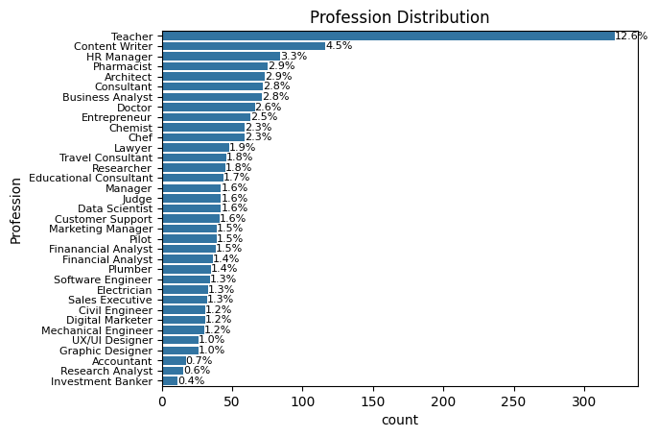
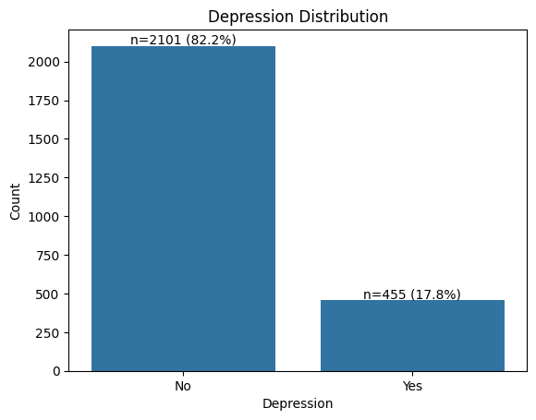

Slide 9
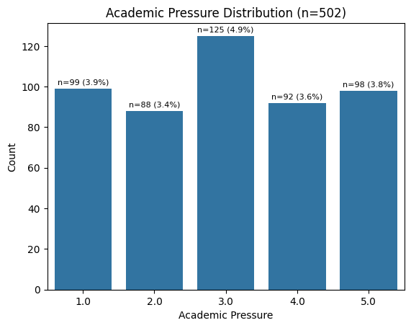
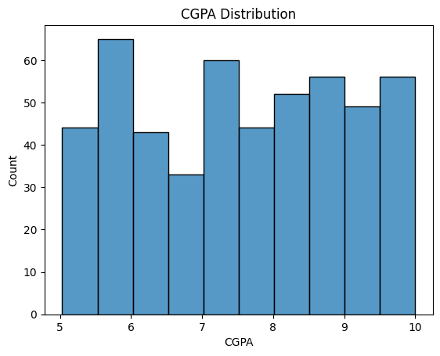
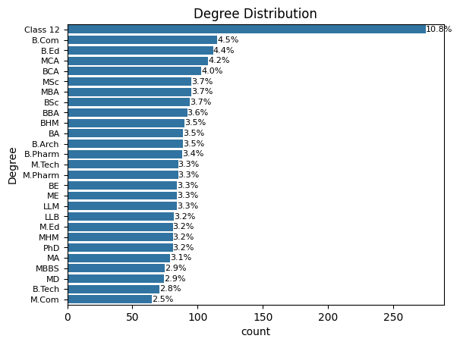
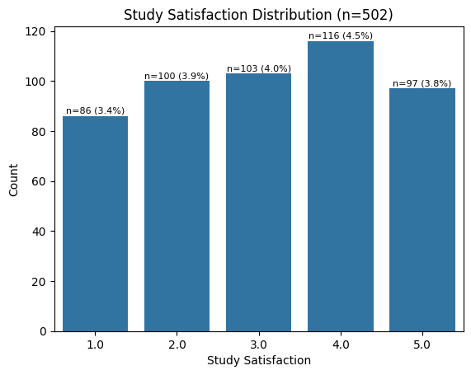
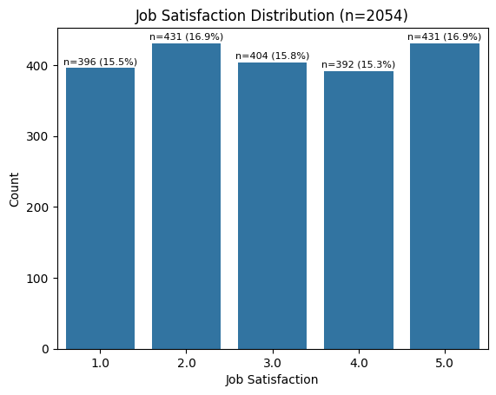
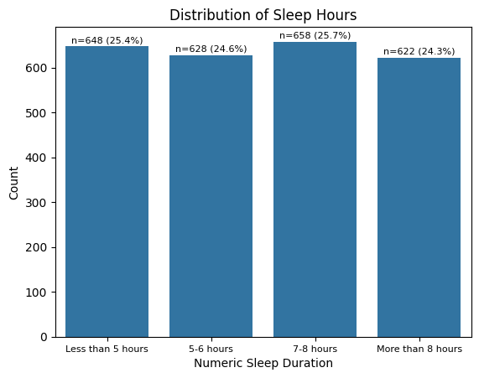

Slide 10
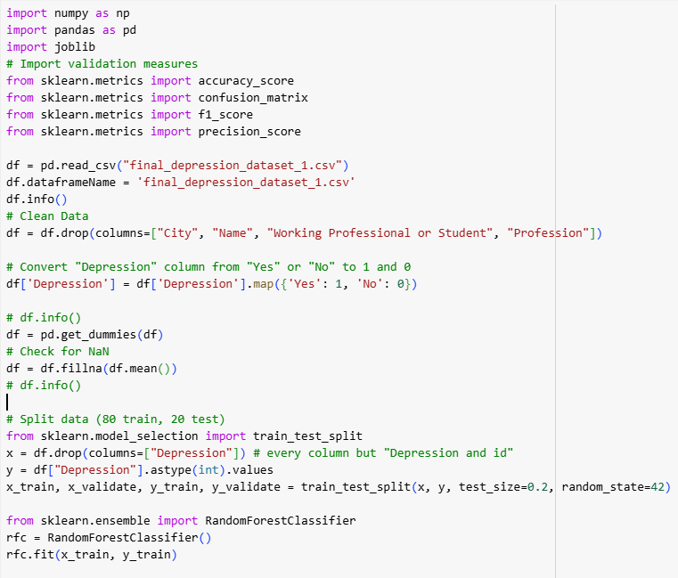
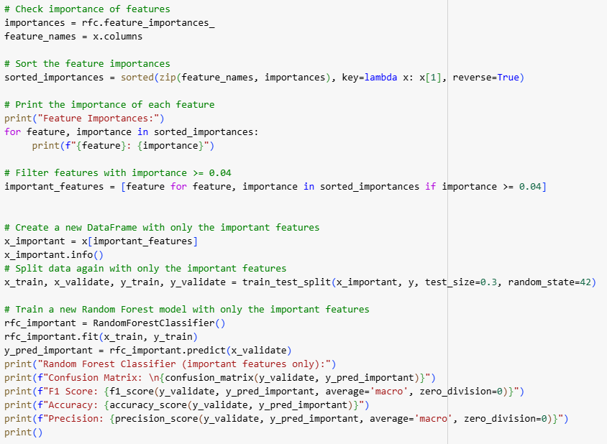
Data cleaning and Model Creation
Initial training
Retraining using important
features (>=0.04)

Slide 11
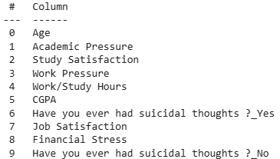
Model results
Feature Importances (initial model)
Significant Features
Age: 0.22125141570475626
Academic Pressure: 0.09550691870820488
Work/Study Hours: 0.06156549688621027
Work Pressure: 0.05986480054923795
Job Satisfaction: 0.05752334413610503
Study Satisfaction: 0.0562865552784107
Financial Stress: 0.05397728553513252
Have you ever had suicidal thoughts ?_Yes: 0.05081877386597323
Have you ever had suicidal thoughts ?_No: 0.04814224352760411
CGPA: 0.047881734626808774
Degree_Class 12: 0.03149843463587658
Dietary Habits_Unhealthy: 0.014982697544837735
Sleep Duration_Less than 5 hours: 0.012693887609224552
Family History of Mental Illness_No: 0.011527801960641983
Gender_Male: 0.011234526834998466
Dietary Habits_Healthy: 0.011231855612793941
Family History of Mental Illness_Yes: 0.010794055273625276
Sleep Duration_More than 8 hours: 0.010587209867749721
Sleep Duration_7-8 hours: 0.010583408627031166
Sleep Duration_5-6 hours: 0.010503053957603392
Gender_Female: 0.010499632402621644
Dietary Habits_Moderate: 0.009685770066291942
Degree_B.Com: 0.005431144189150475
Degree_B.Ed: 0.005295954055698295
Degree_LLB: 0.004789657384430519
Degree_BE: 0.0047508471428563655
Degree_MSc: 0.004604395400657041
Degree_BCA: 0.004474412467236216
Degree_MA: 0.0043201792568659395
Degree_B.Arch: 0.004123128591137051
Degree_MCA: 0.003796720619366126
Degree_LLM: 0.0037496436867873245
Degree_M.Tech: 0.0036982612249569415
Degree_B.Tech: 0.0034571998077801746
Degree_MHM: 0.0034132452240890516
Degree_BHM: 0.0032826943547583694
Degree_B.Pharm: 0.003269760389849572
Degree_BBA: 0.0032018300497852325
Degree_M.Ed: 0.00294813615663254
Degree_BSc: 0.0029315302688825203
Degree_PhD: 0.002820269402545776
Degree_MD: 0.0027764256748783207
Degree_MBBS: 0.00270992846618771
Degree_M.Pharm: 0.002689507948291148
Degree_BA: 0.0025636405246931893
Degree_MBA: 0.002379084657514192
Degree_ME: 0.002010491993382963
Degree_M.Com: 0.0018710078498468754
F1 score, Accuracy,
and Precision (trimmed model)
F1 Score: 0.8927059849246395
Accuracy: 0.9439374185136897
Precision: 0.8968376068376069

Slide 12
Limitations
Limited Dataset - Our sample was very small (n=2552), limiting our accuracy for our model, and choosing what type of model we could choose.
Skewed Variable Distributions - Non-uniform variable distributions can adversely affect the training of the model.
Sample Bias - Our dataset is from surveys taken from multiple cities across India. This data may not be a true representation of the United State or global population.
Respondent Accuracy - We expect each respondent to fill out the survey truthfully and accurately, but this may not be the case for every respondent.

Slide 13
Conclusion
Our team successfully trained an accurate AI model to generate a predictive diagnostic for end users. Using an interactive website, we can have users fill out a short survey in order to receive a predicted diagnostic and be presented with available resources and recommendations.

